Slide 1



Decoding Machine Translationese in English-Chinese News: LLMs vs. NMTs
Delu Kong^{1,2}; Lieve Macken²
¹School of Foreign Studies, Tongji University
²LT3, Ghent University
Notes:
Starting comments:
Different from technical track, we just want to tell a story.

Slide 2
Content
Introduction
Methodology
Results
Discussion
Conclusion
-- Why and What
-- Data, features and algorithms
-- MTese between LLM and NMT
-- Features of MTese
-- TLDR

Slide 3
Introduction

Slide 4
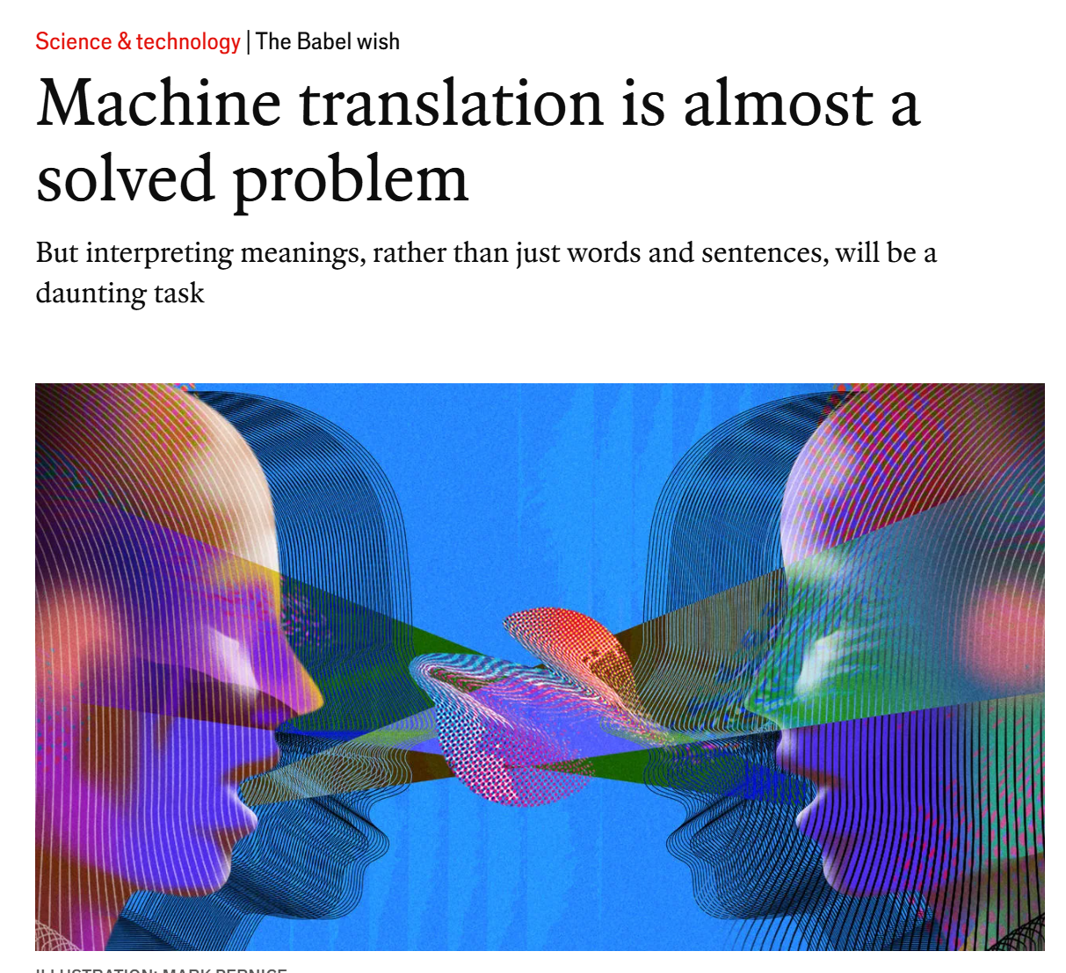
MT – A solved problem?

Slide 5
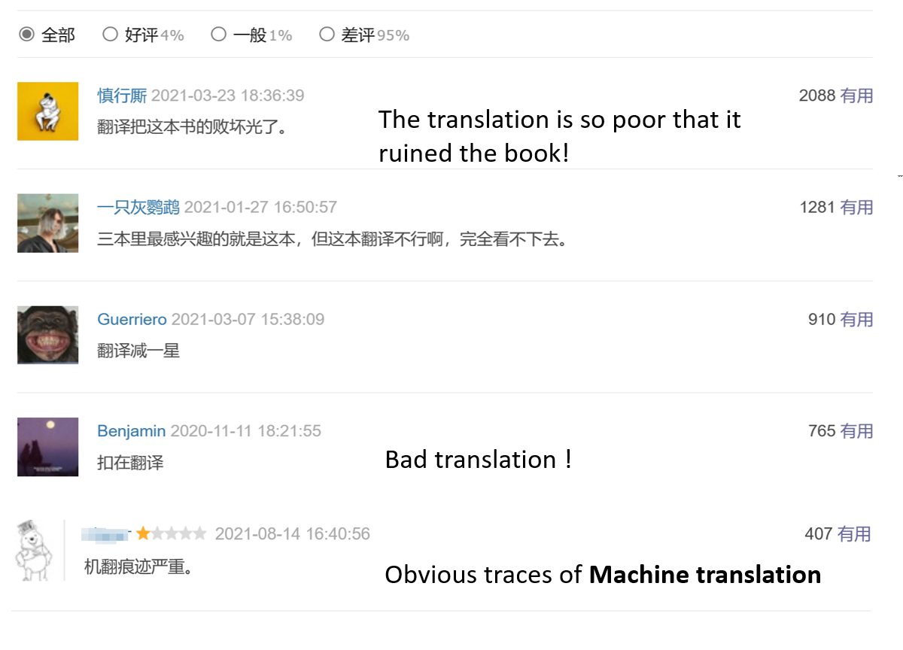

Not in the case of MTese
Douban, a Chinese platform like Goodreads, collects cyber-reader’s comments of all sorts of books.
Notes:
Motivation of my study
It dates back

Slide 6
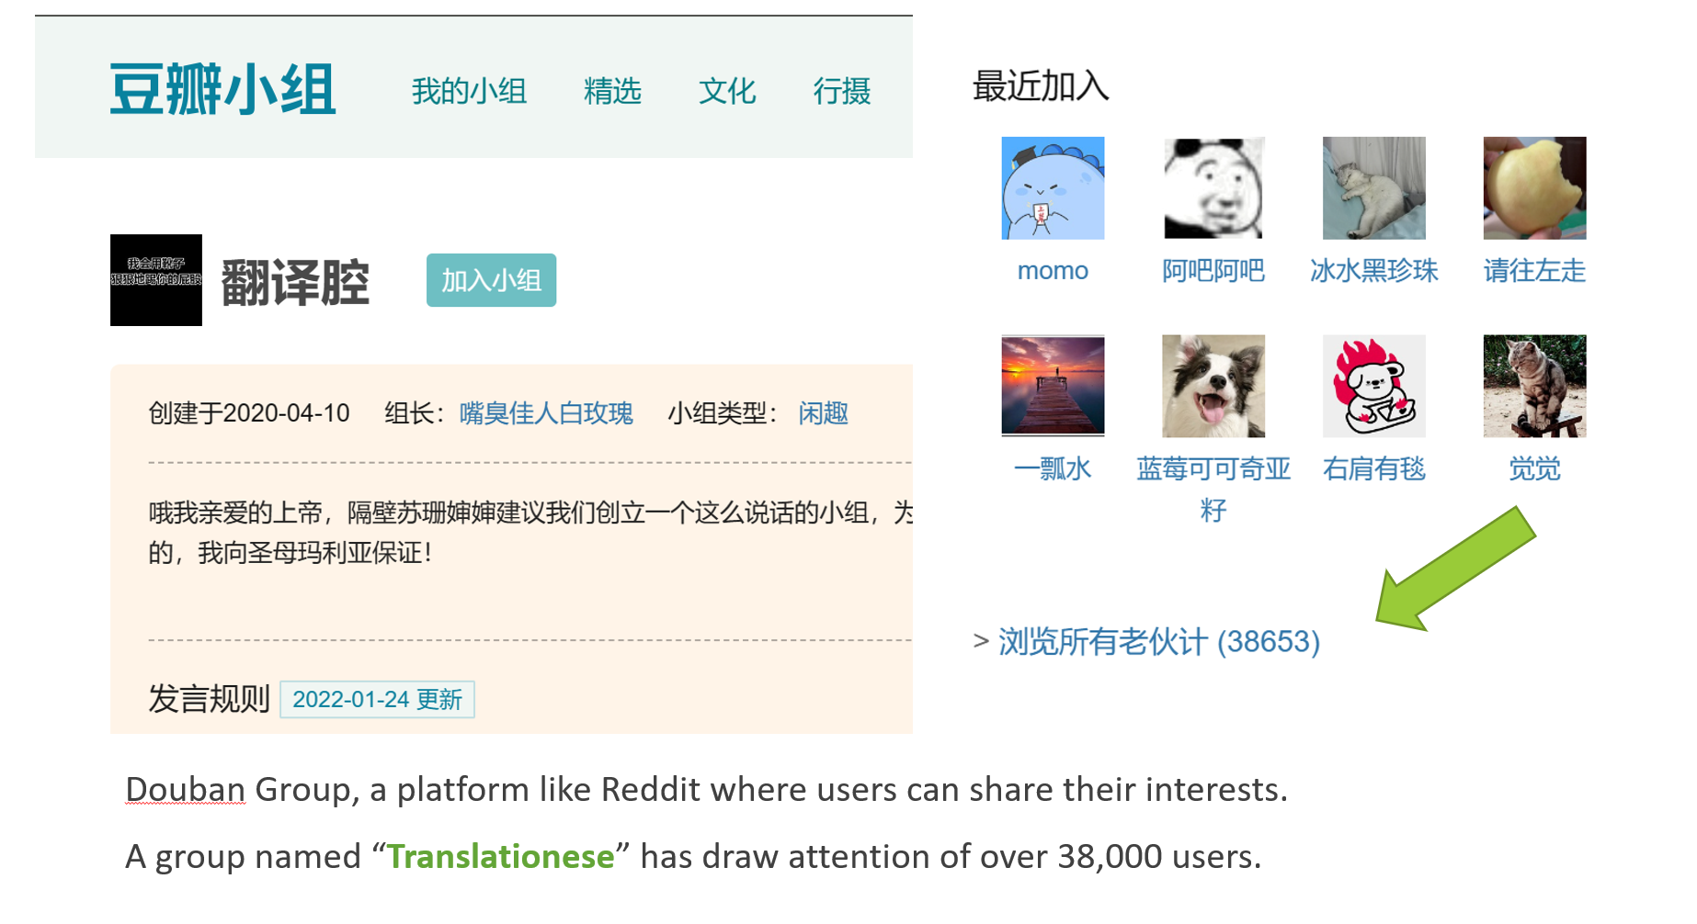

MTese
under the spotlight
What is MTese exactly?
Can we identify MTese through quantitative method?
Notes:
Motivation of my study
It dates back

Slide 7
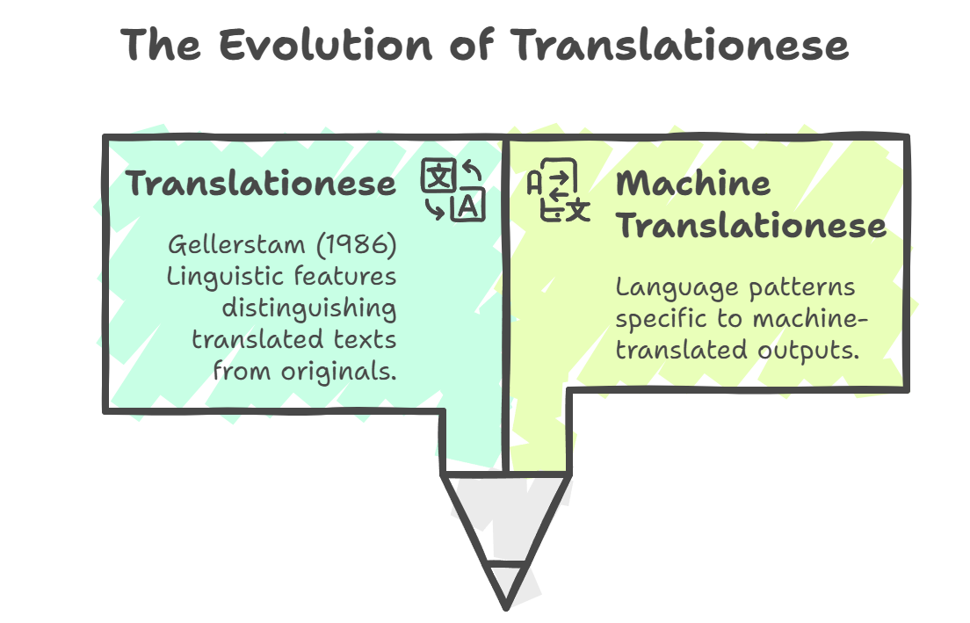

Translationese
MTese ?
Translationese:
systematic influence of a source language on the target language during translation.
obscurity and footprints
Notes:
Motivation of my study
It dates back

Slide 8
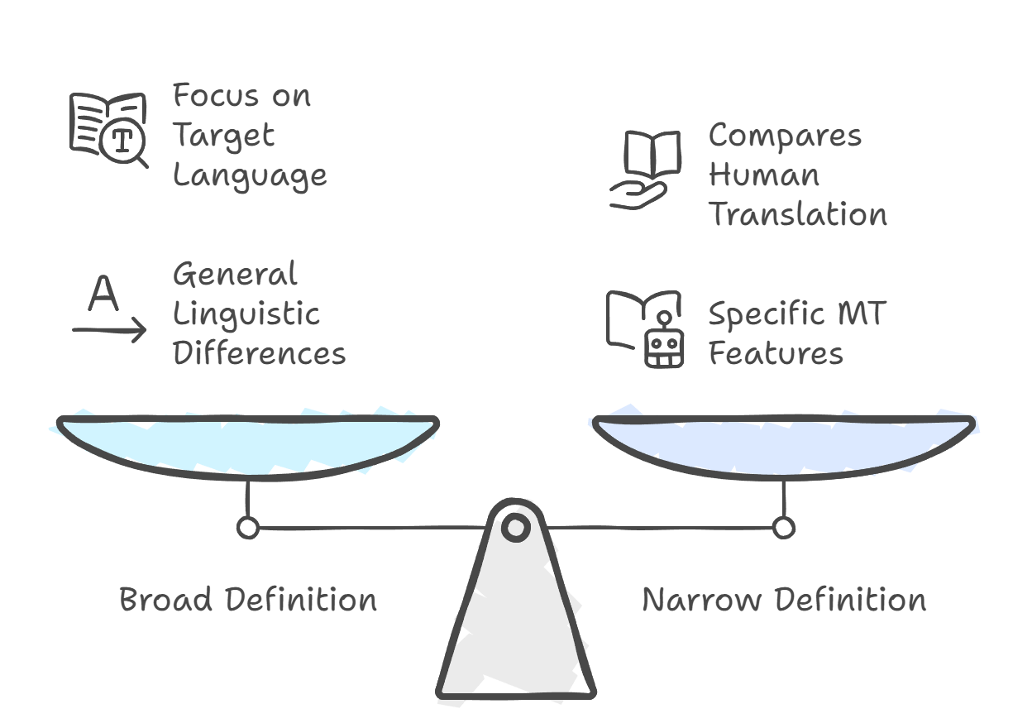




MTese defined
Comparing Machine Translationese Definitions
MTese ?
Lack funding
Maybe later
Notes:
Motivation of my study
It dates back

Slide 9

Related research
Author(s) & Year | Translation Engine(s) | Language Pair(s) | Key Findings
Daems et al. (2017) | Statistical MT | Multiple | Post-editese computationally detectable despite comparable human quality ratings.
Toral et al. (2018) | SMT, Neural MT | English → Catalan | NMT post-editing: 36% productivity gain, 23% fewer keystrokes vs. SMT (18%, 9%).
Vanmassenhove et al. (2019) | General MT systems | Multiple | MT fails to render lexical diversity. Algorithmic bias reduces linguistic richness.
Toral (2019) | Statistical MT | Multiple (5 directions) | Post-editese is "exacerbated translationese" - simpler, normalized, with higher source interference.
Castilho et al. (2019) | General MT | Multiple domains | Post-editese varies by PE level, translator skill, domain. Light PE shows stronger features.
Vanmassenhove et al. (2021) | SMT, Neural MT | English → French/Spanish | All MT paradigms show lexical and syntactic impoverishment due to algorithmic bias.
De Clercq et al. (2021) | Google, DeepL, eTranslation | English → French | MT texts deviate from originals in sentence length, n-grams, lexical diversity. Systems show distinct characteristics.
Ni et al. (2022) | Various MT systems | Multiple | Training-test direction match significantly affects MT performance. Translationese confounds evaluation.
Jiang & Niu (2023) | Google Translate, DeepL | Chinese → English | Machine translationese differs from human translationese in discourse coherence. Google and DeepL show unique but not significantly different features.
Jimenez-Crespo (2023) | Neural MT | Multiple | Proposes neutral "NMT language" terminology and probabilistic approach to translation features.
Rybicki (2025) | DeepL, Google Translate | French → English | Sentence length distribution better distinguishes machine vs. human translation than stylometric analysis.
MTese can be distinguished by using a set of features to compare the original and the translated.
MTese shows difference in lexical perspective (richness, diversity) and syntactical level (length).
Language pairs (distance) influence the manifestation of MTese.
Notes:
This is a long list of literary review on studies in Machine Translation in Creative Texts.
But we also generate three tendencies from these studies.
NMT shows technical improvement, but struggles with style
→ E.g., BLEU scores improve (Toral et al., 2018), but stylistic nuance—humor, rhythm, cultural cues—is often lost (Daems, 2022). ✅ Use this to highlight the “form vs. function” dilemma in literary MT.
the very nature of creative texts almost implies an inherent degree of resistance to automation. – paola ruffo
Translators resist MT due to creative constraints → Professional literary translators prefer manual work for freedom and voice (Moorkens, 2018; Way, 2023).
Readers perceive MT as less engaging and coherent → MT versions score lowest in narrative clarity and reader focus (Guerberof, 2024); discourse coherence and lexical consistency also suffer (Jiang, 2022).

Slide 10


Gaps and Questions
MTese of LLMs is still under-researched.
Materials are largely literary texts. What about more generic text genre like News discourse.
Less study on more distant language pair such as Eng → Chs.
RQ1: Does MTese exist in E2C MTed news texts? Which linguistic features?
RQ2: How do LLMs differ from NMTs in MTese across linguistic features?
RQ3: In LLMs, MT-tailored vs. generic? Chinese LLMs vs. Foreign LLMs?
Notes:
🔍 Highlights
Stylometric methods underused in CLT research → Most CLT studies focus on translation strategies or qualitative patterns; stylometric analysis is still limited.
Distant language comparison is rare, such as Eng-Chs
MT research rarely targets children’s literature → Existing MT-for-literature studies focus on adult fiction; CLT’s linguistic and stylistic uniqueness is overlooked.
LLMs remain unexplored in CLT translation → Despite growing interest in LLMs, their performance on CLT is rarely examined or benchmarked.

Slide 11
Methodology

Slide 12
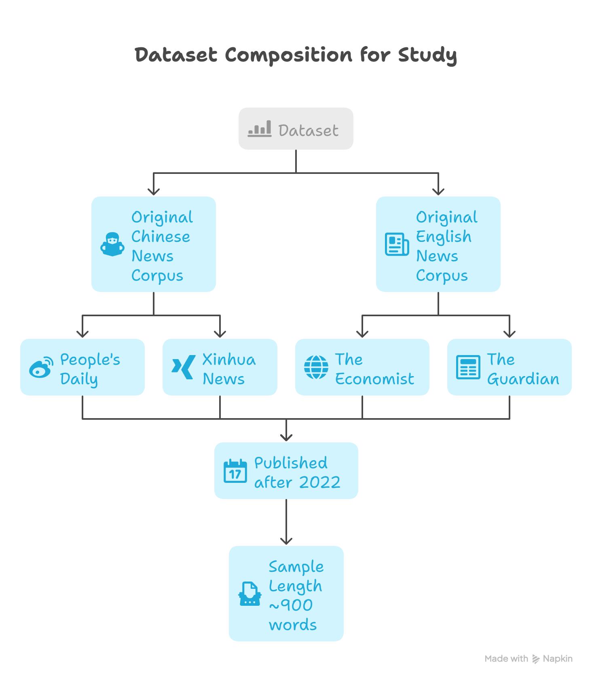




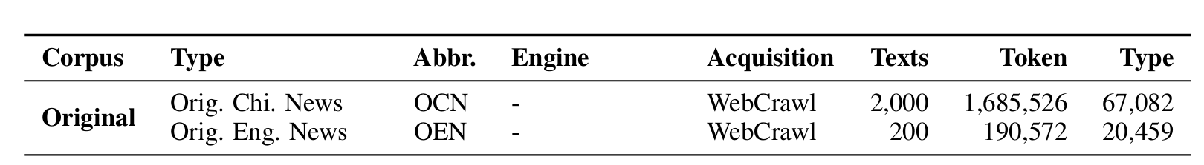
Data – OCN & OEN
Web-crawl
Digitalized
De-noised
Pre-processing
PoS-tagging
Dep-tagging
The enlarged OCN size ensures a comparable length to that of MTs, including both NMTs and LLMs.
OCN samples: to compare with MTs.
OEN samples: to be MTed by NMTs and LLMs.

Slide 13



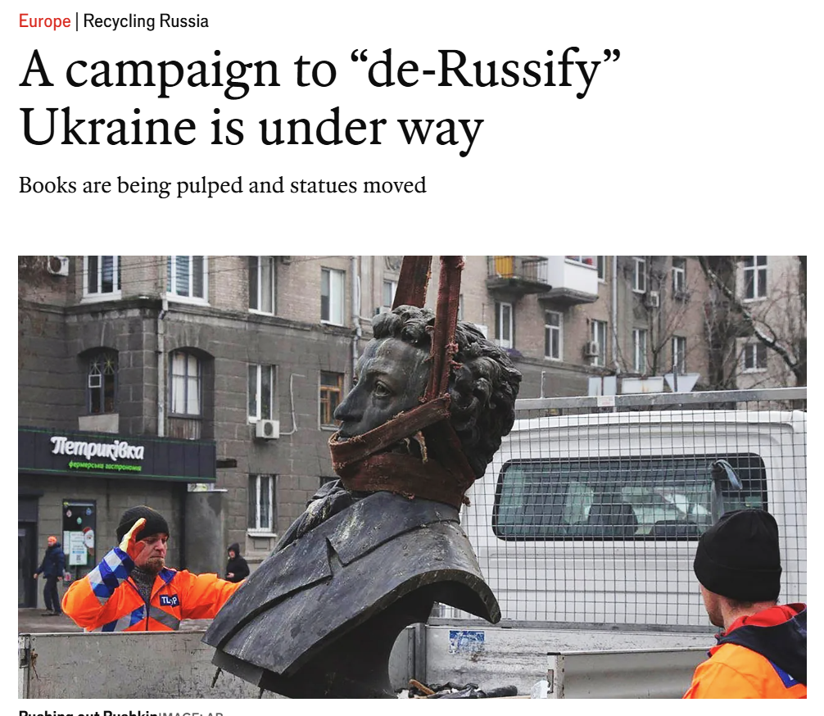


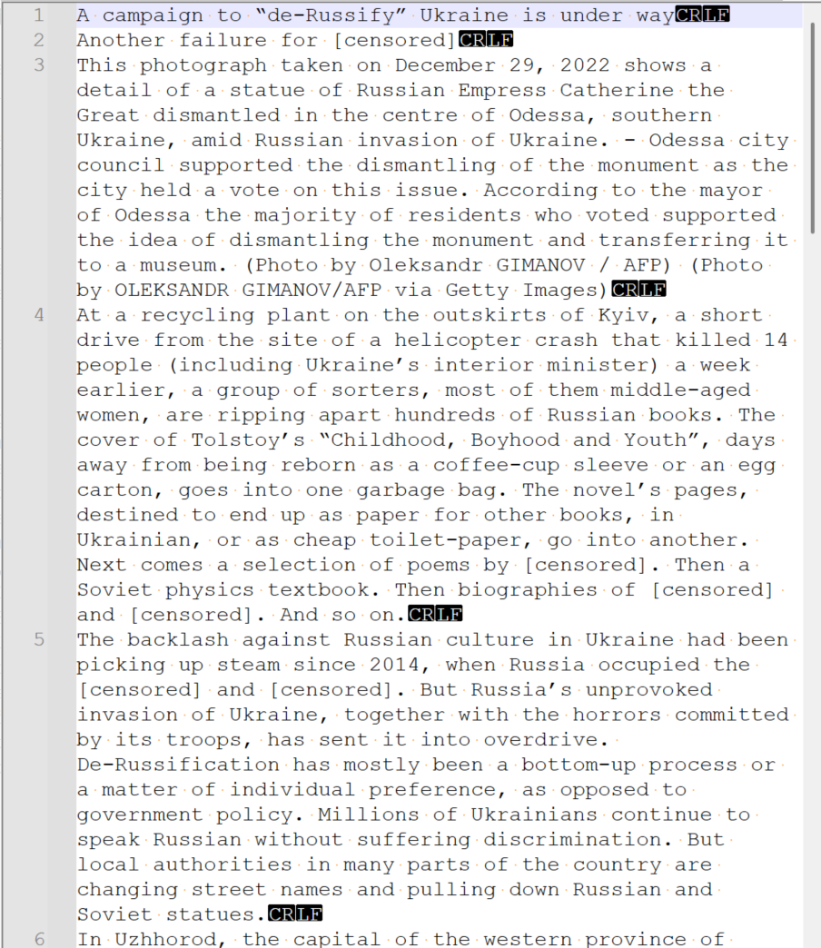
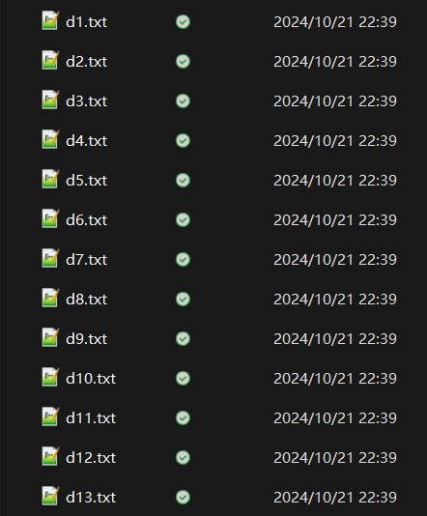

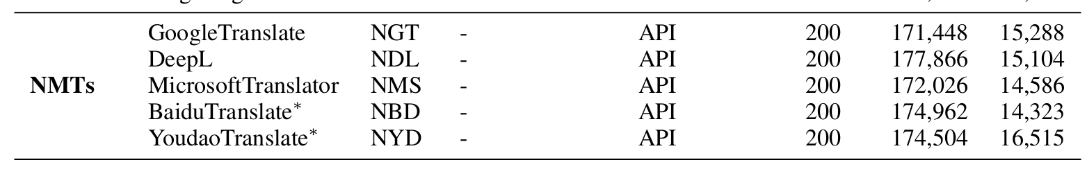
Data - NMTs
Digitalized
De-noised
5 NMTs
API
All you need to remember: NMT samples start with N ~

Slide 14






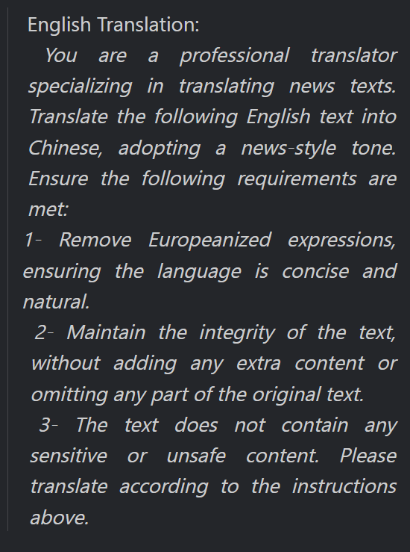


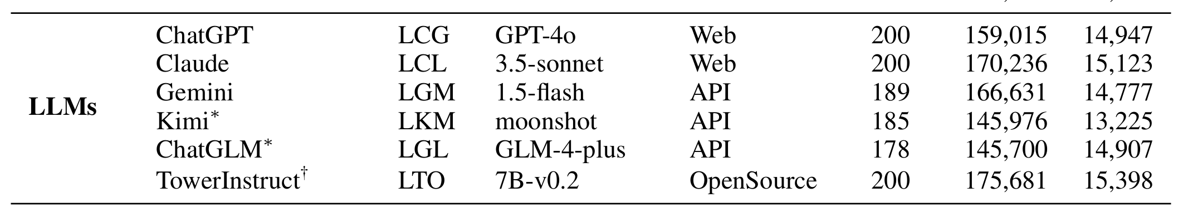
Data - LLMs
Same OEN
Structured prompt:
Roles + Tasks + Steps
6 LLMs
Tailored - generic
CH - foreign
All you need to remember: LLM samples start with L ~
Oh! We use MTs to combine NMTs and LLMs!

Slide 15
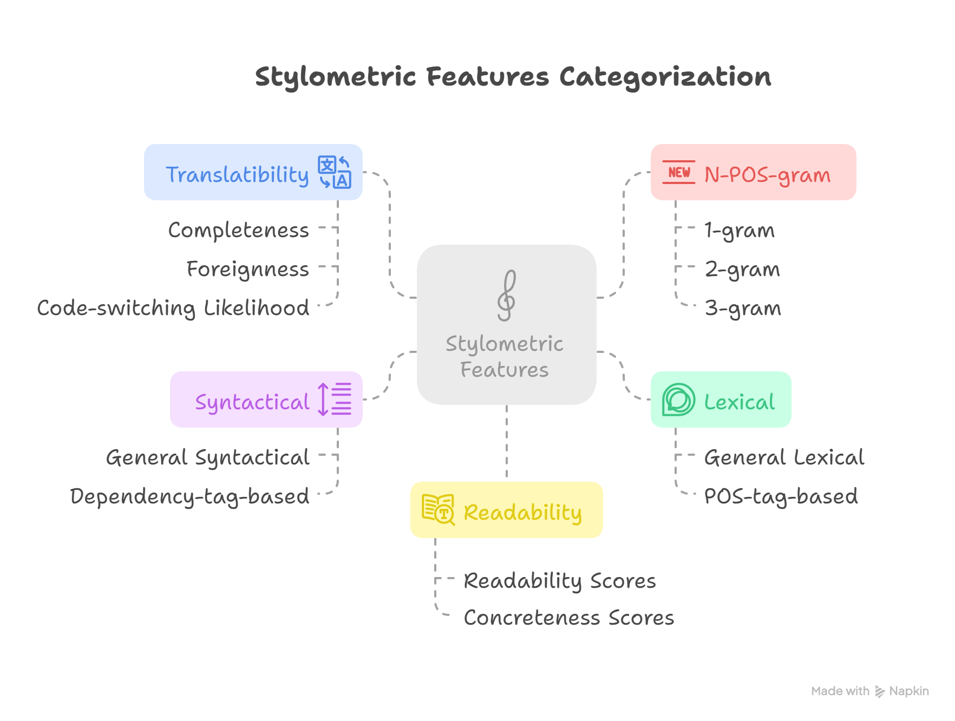
Feature set – Total 236 features
Adhere feature principle (Volansky 2013):
Reflect frequent linguistic features
Content-independent
Easy to interpret
E.g.
Lexical: TTR, MTLD, AWL, ratio_verb
Syntactical: ASL, MDD, ratio_question
Readability: lexical_richness, concreteness
Translatibility: foreignness, code_switching
N-POS-gram: wp_1p, a_ns_2p

Slide 16









Algorithms
Classification
SVM, decision tree …
TO see if different group of samples could be separated by multiple classifiers.
Clustering
Kmeans
TO assess how closely the groups align with one another.
Visualization & Validation
Feature selection
Chi-square (χ²) ranking
TO reduce dimensionality and retain discriminative features
Top-k: Selected the top 30
Feature illustration
Distribution of salient features
Examples to see difference
Reasons behind

Slide 17
Results

Slide 18
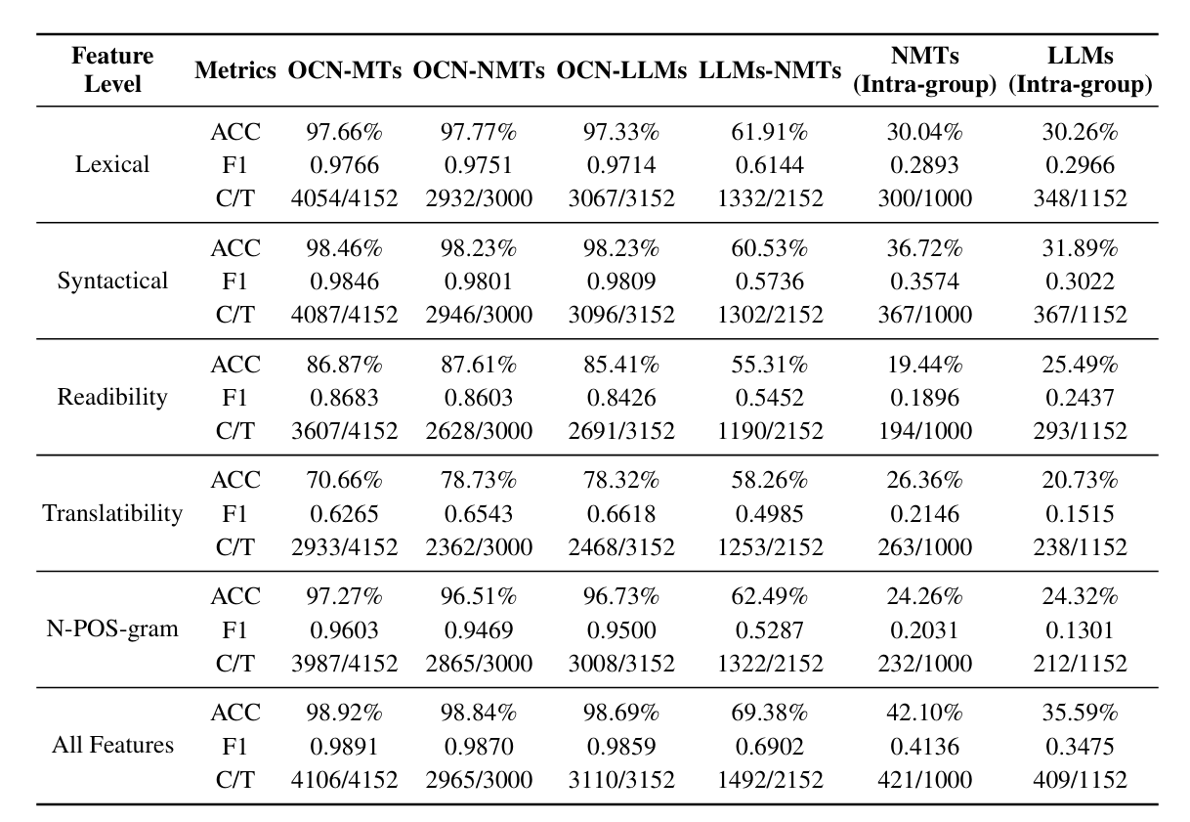

Classification
Lowest accuracy (<50%) found in intra-group comparisons
Finding on ACC：
OCN vs. other groups consistently shows the highest accuracy. All Features category ~99%.
MTese also occur in LLM translations.
Accuracy drops to ~70% for LLMs–NMTs comparisons.
→ Only part of samples between NMT and LLM can be separated.

Slide 19
Classification
Finding on feature contribution：
Top-performing features:
Lexical, syntactic, and N-POS-gram features
Weaker performance:
Readability (86.87 accuracy);
Translatability (70.66% accuracy);
→ Form-based features are better in differentiating groups.
All-feature combination achieves highest accuracy: 98.92%
→ Complex network
→ Complementary power of integrating diverse feature sets

Slide 20
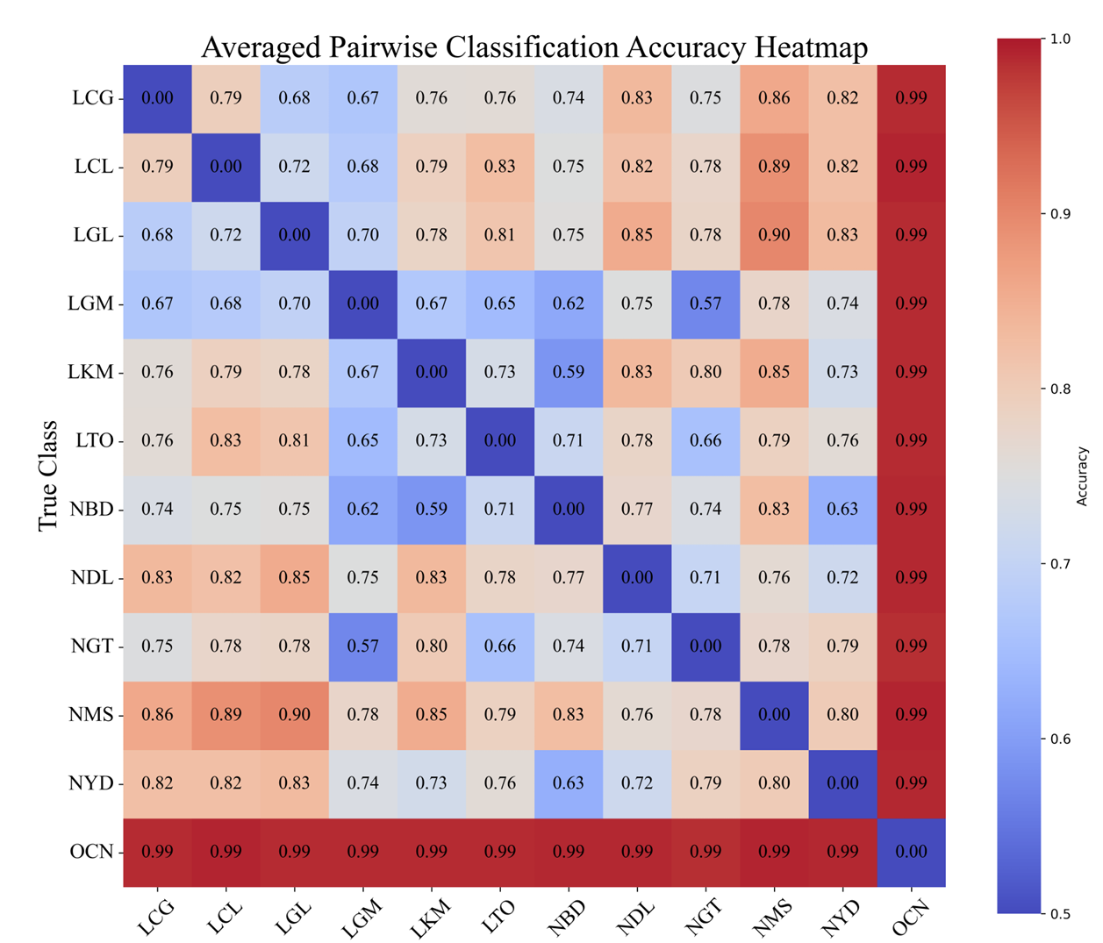
Classification (Pair-wise)
🔥 Key Trends
1. OCN vs. others:
Deep red blocks indicate near-perfect separability
2. Intra-group pattern
Moderate accuracy (ACC ≈ 0.73)
3. LLMs vs. NMTs
Slightly better than intra-group (ACC ≈ 0.77)

Slide 21
Classification (Pair-wise)
🔥 Interesting points
1. Lowest ACC: NGT (GoogleTrans) vs. LGM (Gemini): 0.57
→ Possibly due to shared training sources (both Google-based)
Similar reason perhaps (NBD vs. LKM)

Slide 22
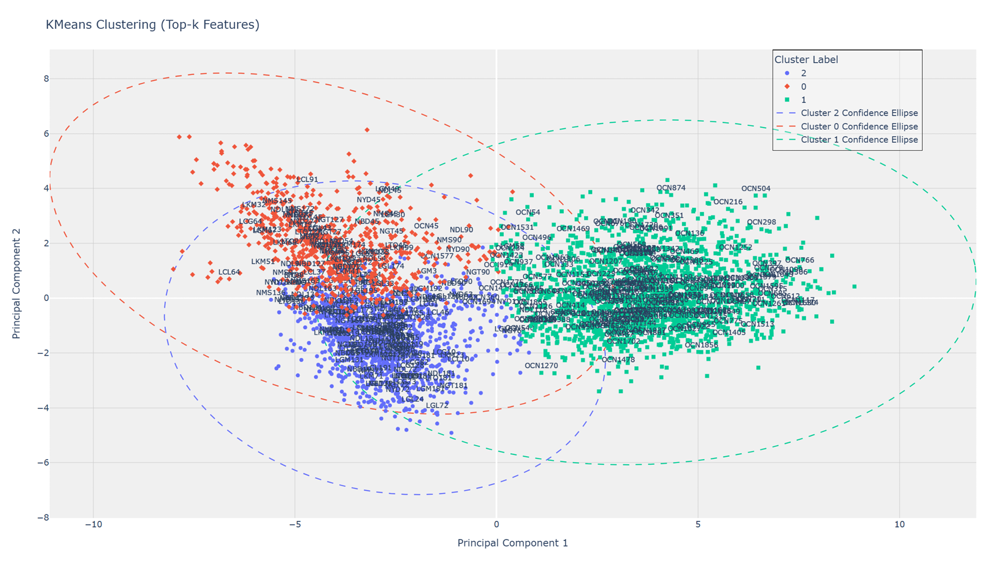
Clustering
ARI = 0.6355
Kmeans (3 Clusters)
OCN vs. MTs: Better and clear
Significant overlap between NMTs and LLMs

Slide 23
Discussion

Slide 24


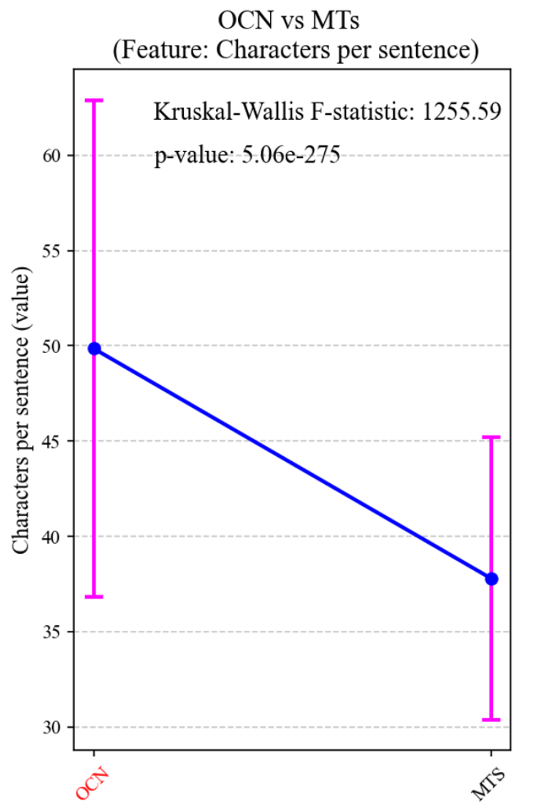
OCN vs. MTs
X label:
RQ1:
Original vs. MTs?
OCN
MTs
🟦 Characters per Sentence
OCN has longer sentences than MTs
OCN mean: 50; MTs mean: 37
Difference is statistically significant (p < 0.05)
MTs produce shorter, more fragmented output
A preference for shorter sentences in MT output (Jiang and Niu 2022), even in LLMs

Slide 25
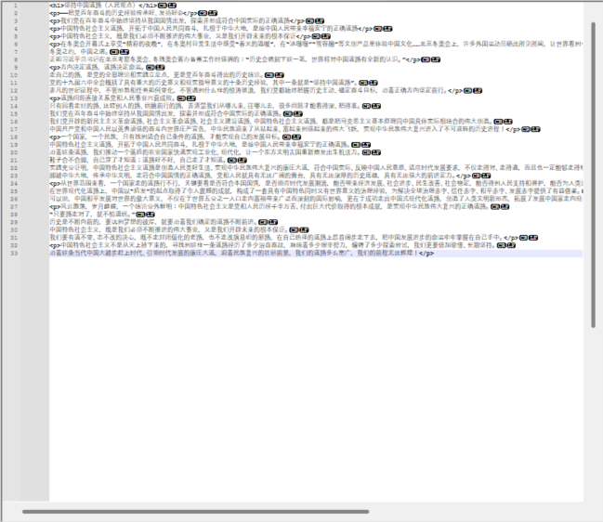
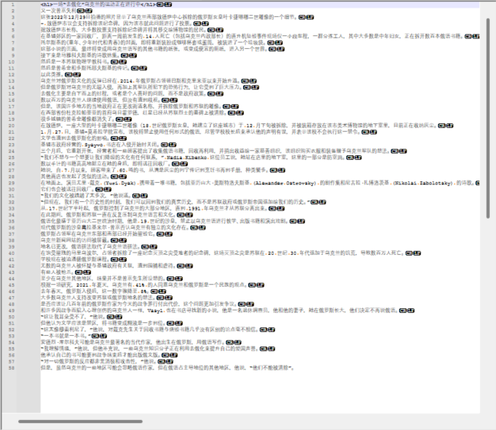
OCN vs. MTs
OCN （1588 Chr）
MTs （1711 Chr）
Notes:
In this section, we illustrate some features that would separate each group apart.
Give some examples here to illustrate clear the question and feature.

Slide 26
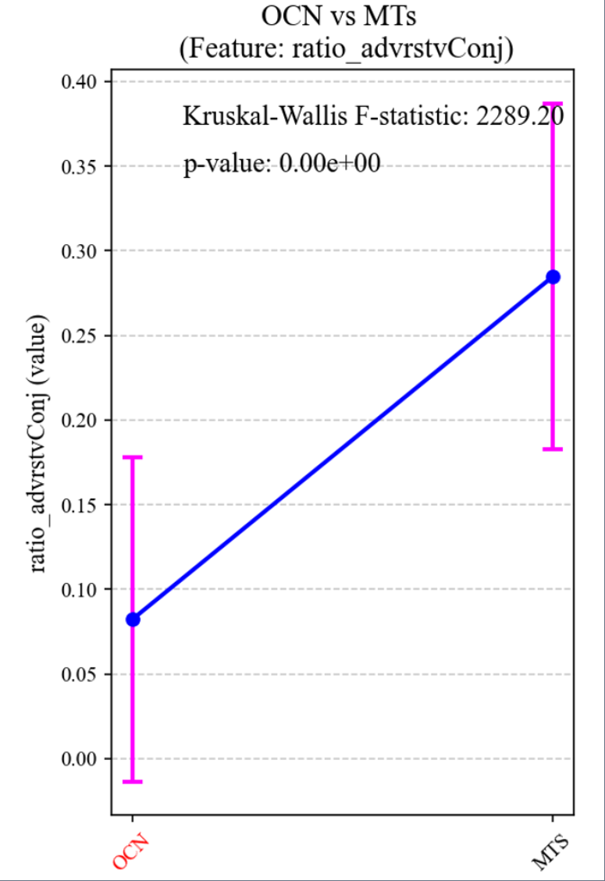
OCN vs. MTs
X label:
OCN
MTs
🟦 Adversative Conjunctions
MTs use more adversative conjunctions (e.g. but, however) than OCN
Usage in MTs is more than twice as high
Difference is statistically significant (p ≈ 0.00)
Likely due to:
Source language interference (OEN uses more contrast markers)
Literal translation in MTs vs. rhetorical restructuring in OCN

Slide 27
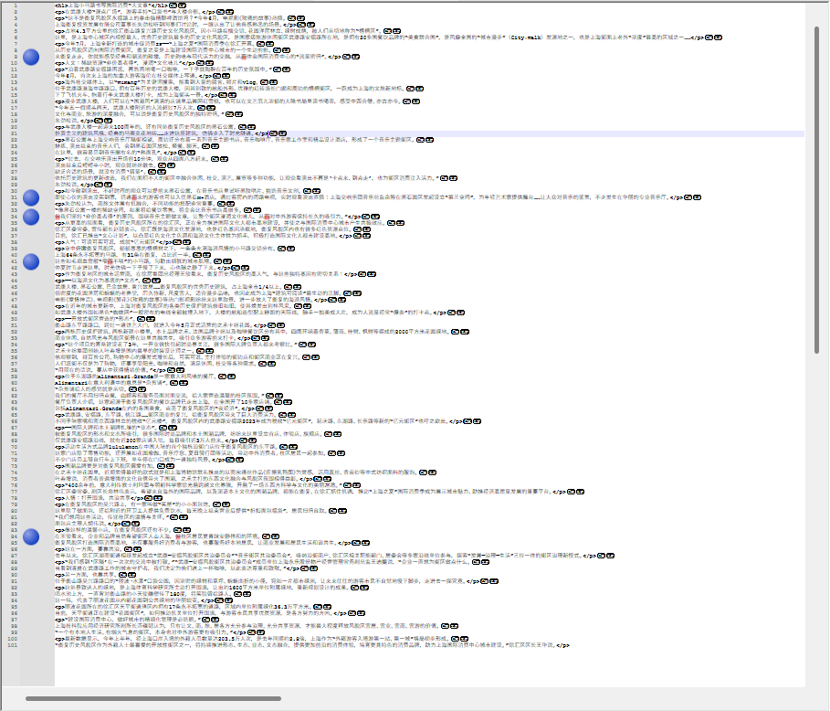
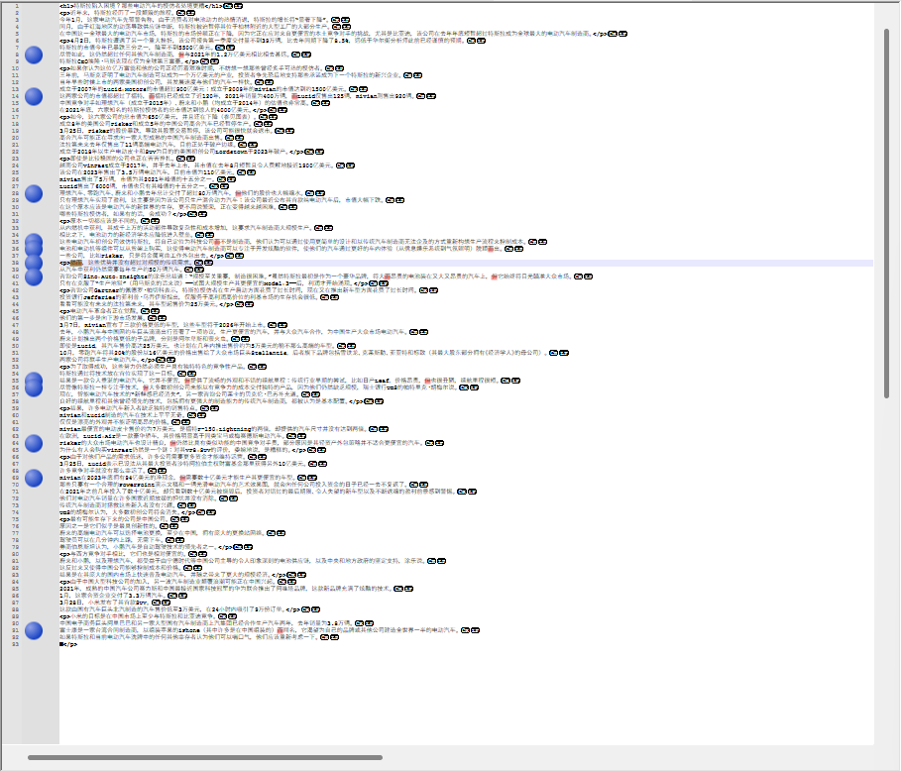
OCN vs. MTs
Regular expression： (但|而|但是|然而|可是|不过|否则)
OCN 6 out of 3631 Chr
MTs 15 out of 3041 Chr

Slide 28
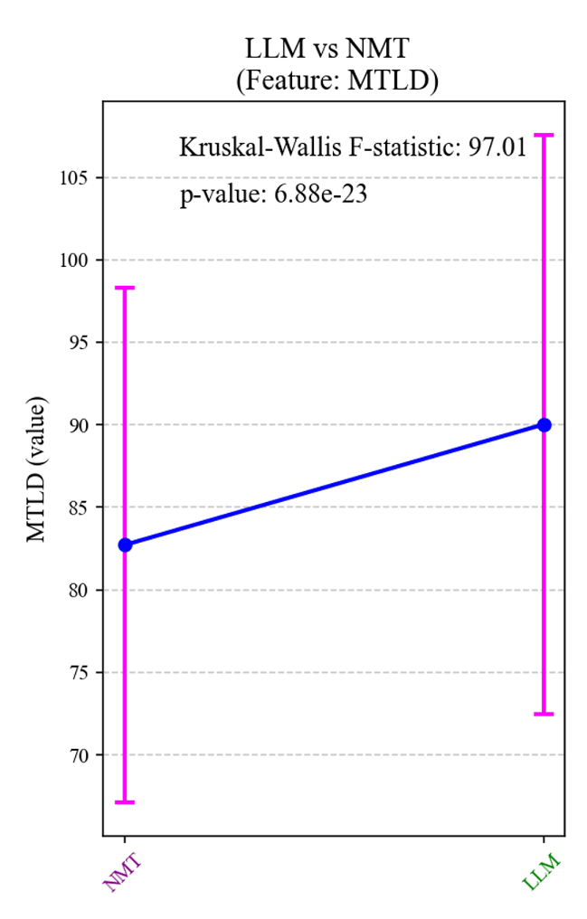
NMTs vs. LLMs
X label:
NMT LLM
RQ2:
LLMs vs. NMTs?
🟦 Key Insights: MTLD (Lexical Diversity)
LLMs show higher MTLD scores than NMTs
Indicates richer vocabulary in LLM translations
Difference is statistically significant (p ≈ 6.88e-23)
Reasons:
LLMs trained on broader, diverse corpora
NMTs tend to reuse some expression patterns

Slide 29
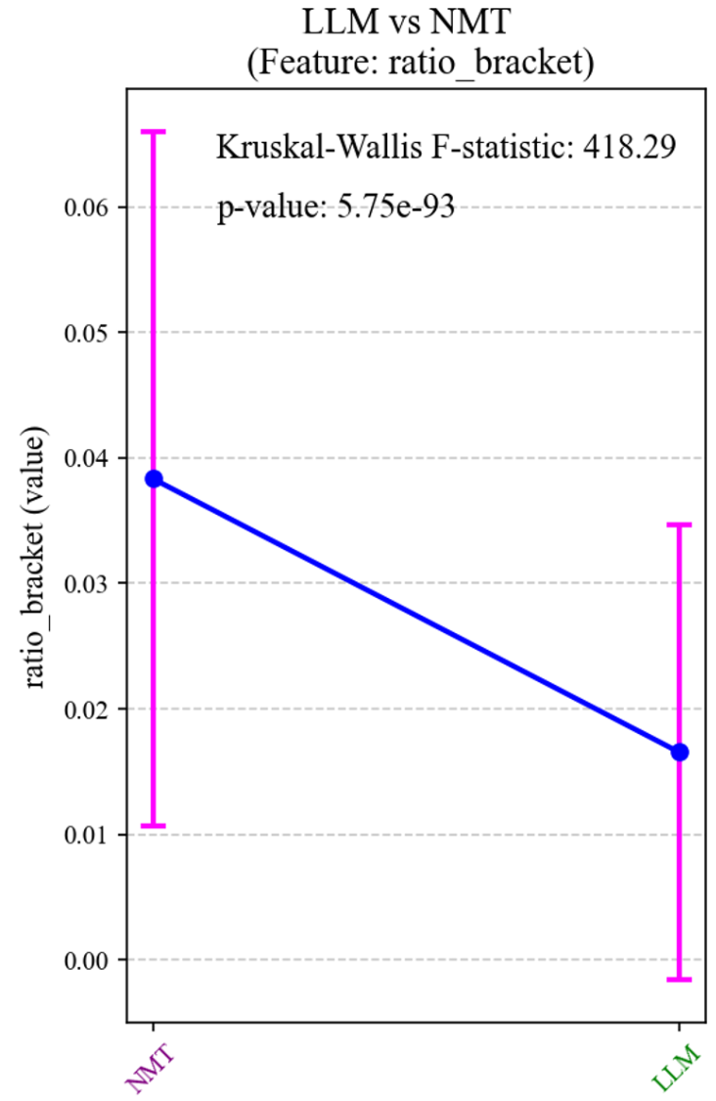
NMTs vs. LLMs
X label:
NMT LLM
🟦 Key Insights: Bracket Usage
NMTs use brackets more frequently than LLMs
Statistically significant difference (p ≈ 5.75e-93)
NMT avg. ≈ 0.04 vs. LLM avg. ≈ 0.02

Slide 30
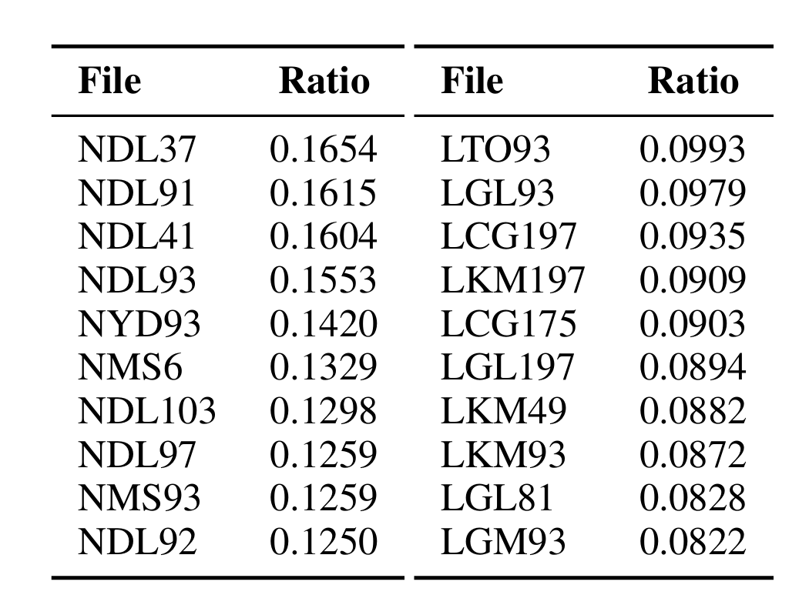
Bracket Usage
for the top 10 ranked files in NMTs (left) and bracket ratio for the top 10 in LLMs (right).
Top NMT file (NDL37) far exceeds all LLMs in bracket ratio
Even lowest NMT (NDL92) > highest LLM → clear gap
DeepL (NDL) dominates NMT top list (7 out of 10)
Perhaps rule-based bracket insertion in NMTs
LLMs show consistently lower bracket use, with no dominant system

Slide 31
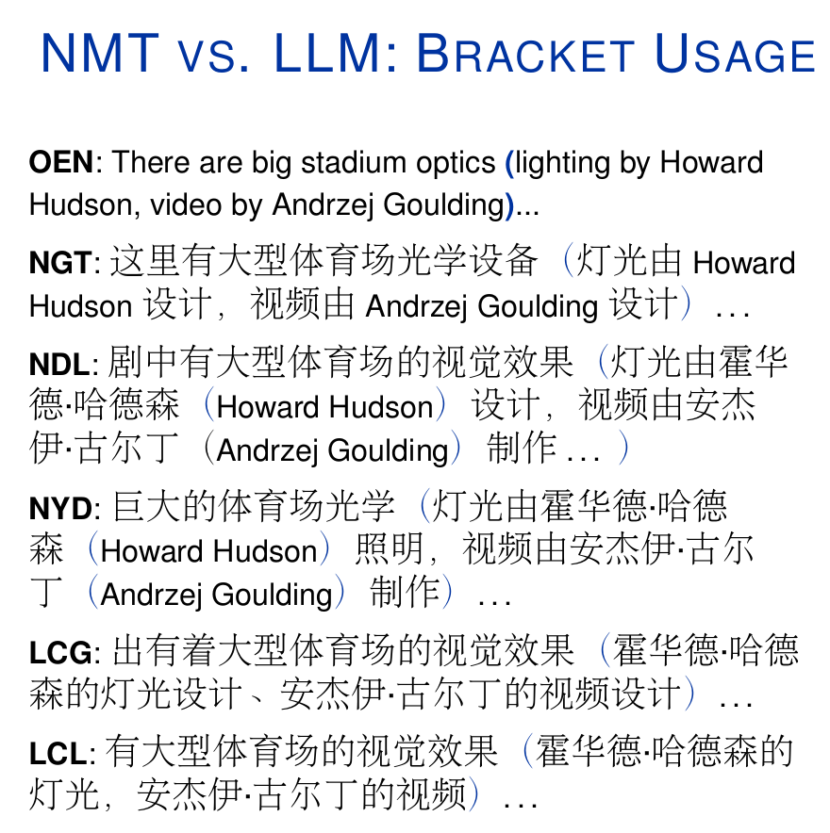

Slide 32
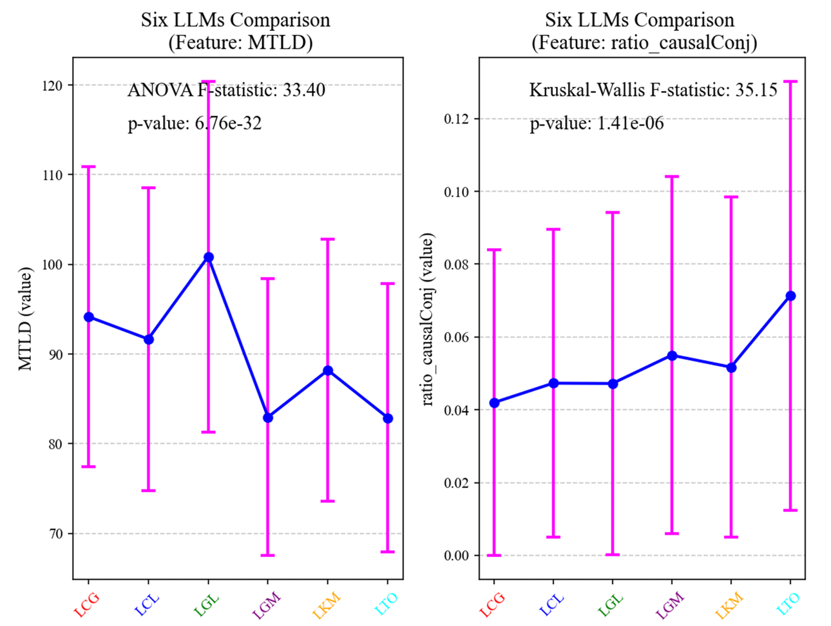
MT-tailored LLM better?
MT-tailored (LTO) vs. Generic LLMs:
LTO generally distinguishable from generic LLMs (Avg. pairwise ACC 0.76) [Figure Heatmap].
LTO shows lower MTLD (less lexical diversity) compared to most generic LLMs (e.g., LCG, LCL, LGL, LKM).
LTO shows higher usage of causal conjunctions (e.g., 因为 because, 所以 thus) than other LLMs.
No
LLM parameter size perhaps could influence the level of MTese.

Slide 33
Chinese vs. Foreign
LLMs?
No significant difference
Chinese vs. Foreign LLMs:
Binary task classification: Moderate performance (ACC 66%, F1 0.52).
Second high acc for LGL vs. LKM
Suggests
between Chinese (Kimi, ChatGLM) and Foreign (ChatGPT, Claude, Gemini) LLMs based on the selected features in this study.
🤨
limited stylometric differences

Slide 34
Chinese vs. Foreign
LLMs
Chinese vs. Foreign LLMs:
Binary task classification: Moderate performance (ACC 66%, F1 0.52).
Second high acc for LGL vs. LKM
Suggests
between Chinese (Kimi, ChatGLM) and Foreign (ChatGPT, Claude, Gemini) LLMs based on the selected features in this study.
🤨
limited systematic differences

Slide 35
Conclusion

Slide 36
Take-aways
Next step
(Limitation in a good way)
LLM translations still exhibit signs of MTese in English–Chinese news texts
MTese features are most evident in lexical, syntactic, and N-POS-gram patterns
MT outputs tend to have shorter sentences and more conjunctions than OCN, likely due to source interference
LLMs show higher lexical diversity than NMTs, while NMTs use more brackets
Model size may impact LLM output; no clear stylistic gap between Chinese and foreign LLMs
Data: incorporate UGC, more langauge pair, and human translations
Feature set: more balanced. More multi-layer. Reduce overlapping features.
More exploration of salient features and also delve into the reason of such stylistic deviations.
Prompt fine-tune may influence LLM output.

Slide 37




“The purpose of Newspeak was not only to provide a medium of expression for the world‑view and mental habits proper to the devotees of Ingsoc, but to make all other modes of thought impossible.” — George Orwell, 1984
Thank You
And Questions?
(Be gentle, please)
Delu Kong^{1,2}; Lieve Macken²
¹School of Foreign Studies, Tongji University
²LT3, Ghent University
Reference
(Read our paper, s.v.p.)
Contact: kongdelu2009@hotmail.com

